Slide 1
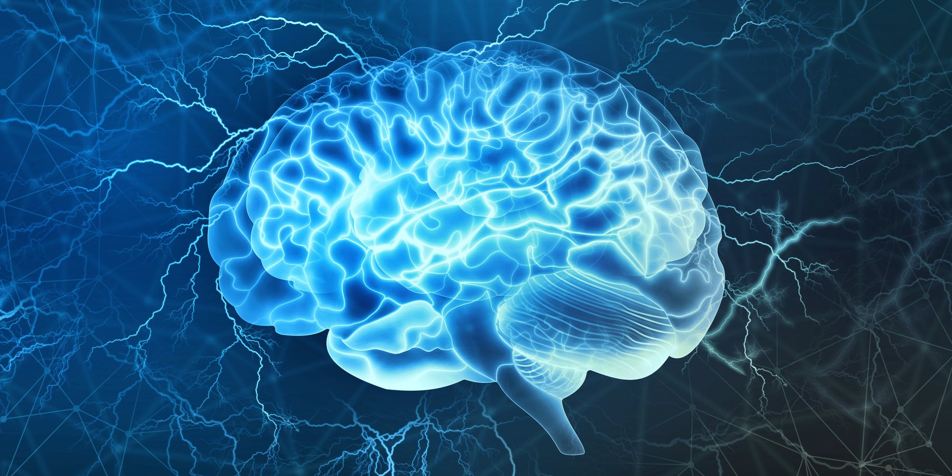
Neural
Engineering
Team
Week.2
2022.09.23 6pm
Lee Seong Jin

Slide 2
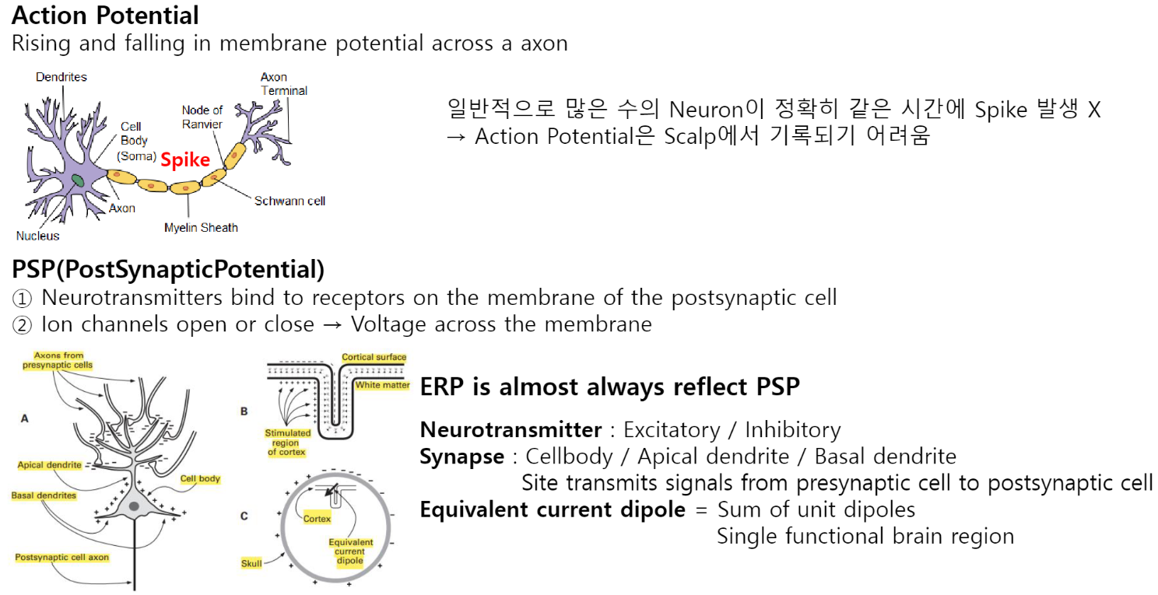
Neural Origin of EEG

Slide 3
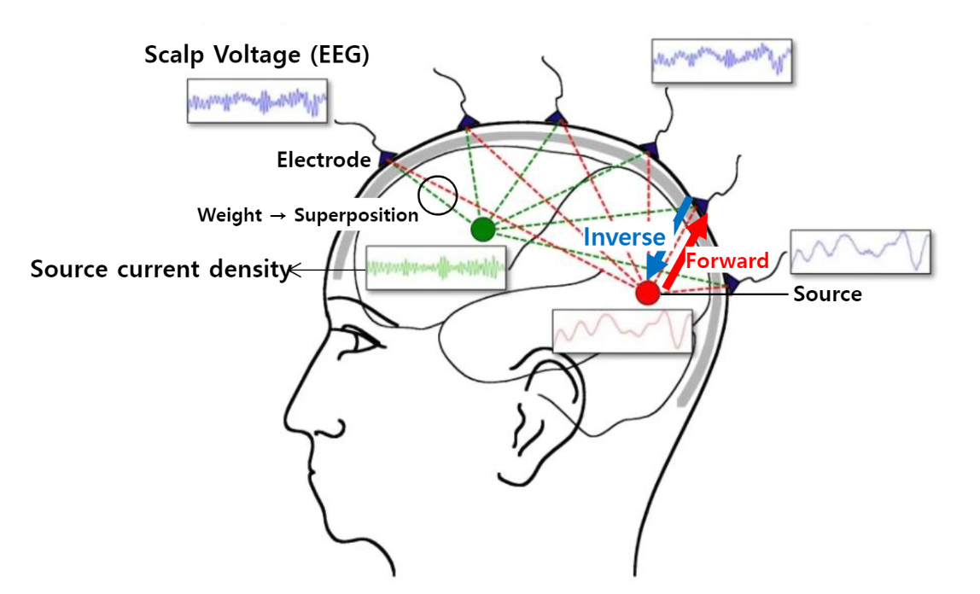
EEG generation

Slide 4
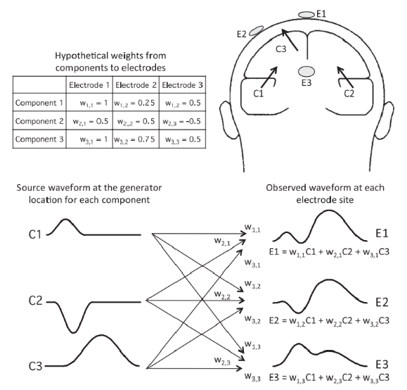
Superposition
EEG : waveform mixed up several source of brain activity

Slide 5
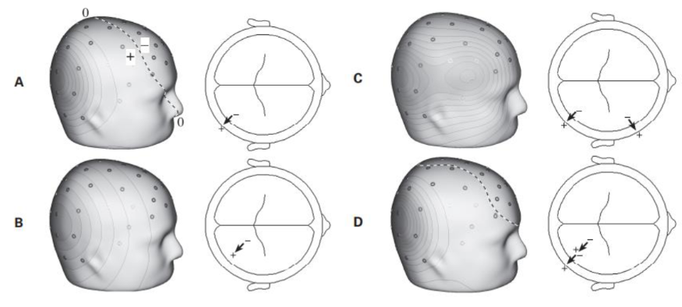
Forward / Inverse Problem
Scalp Voltage Distribution
↑ ↓
Internal underlying brain component

Slide 6
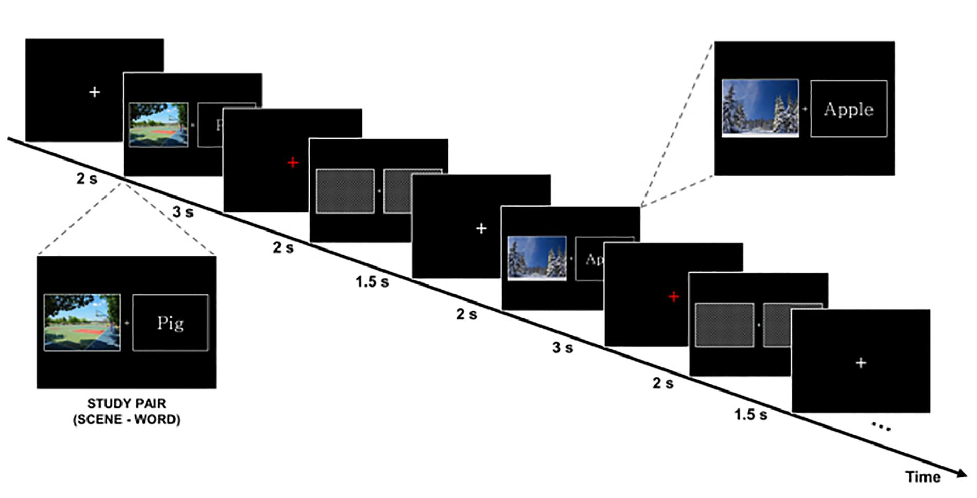
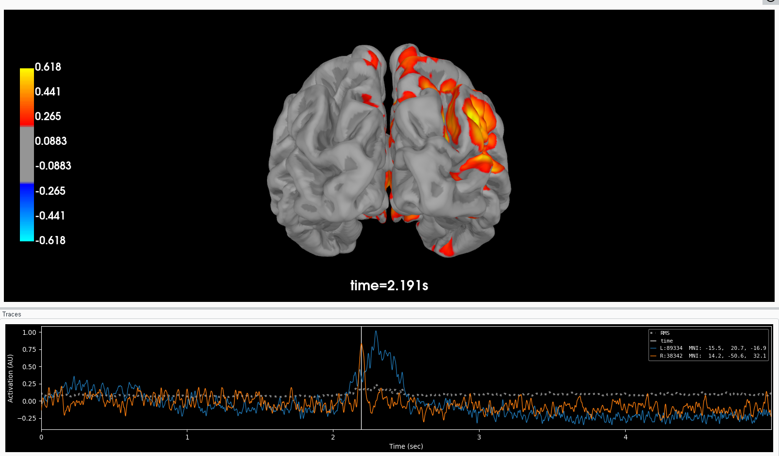
Source Estimation
→ using MNE (python)
Pre-stimulus
(2s)
Stimulus-onset
(3s)

Slide 7
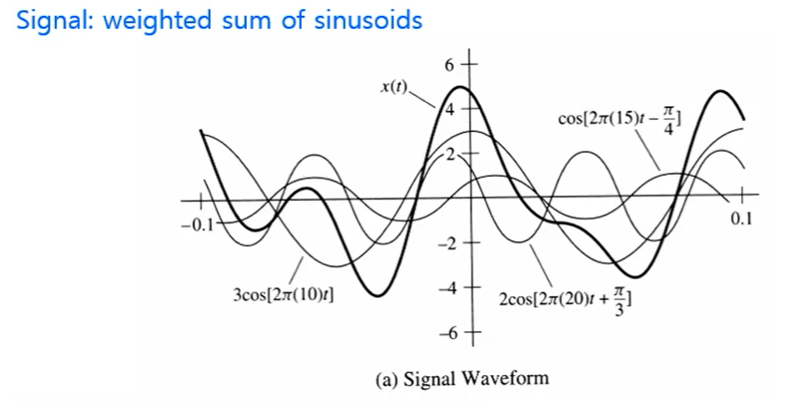
Signal? Noise?

Slide 8
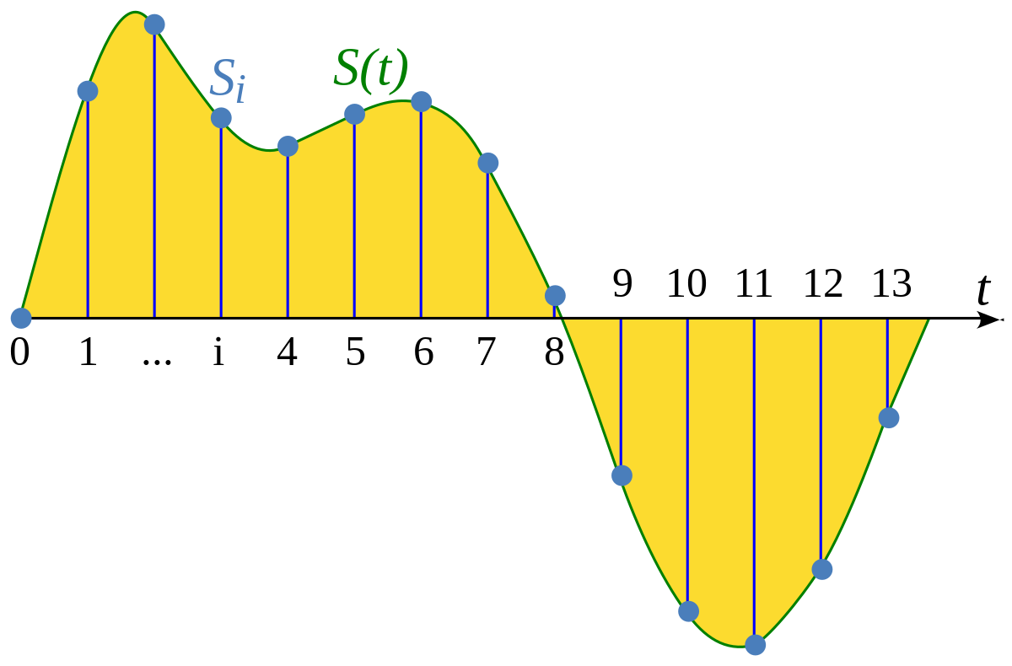
Analog & Discrete

Slide 9
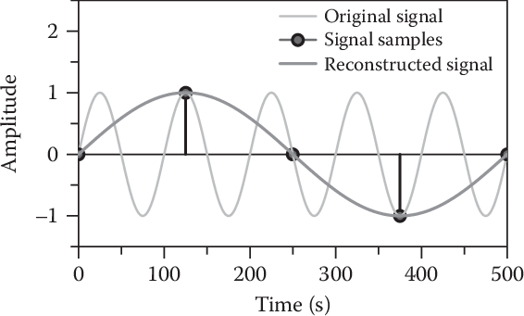
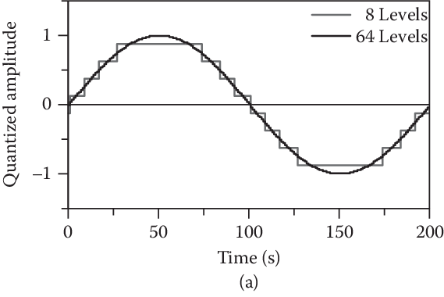
Analog & Discrete
Sampling frequency : 1s를 몇 개의 point로 sampling 했냐?

Slide 10
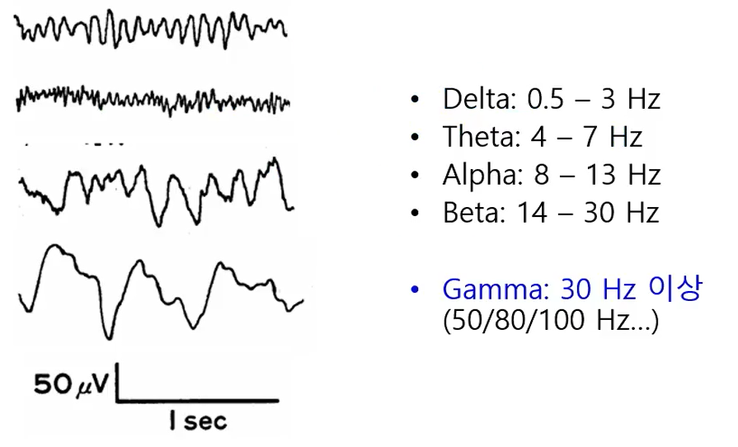
EEG division by Frequency

Slide 11
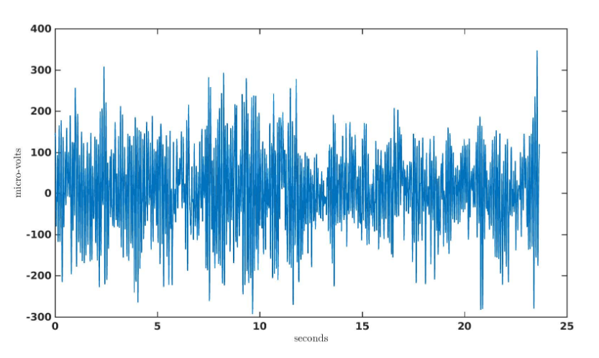
Example of EEG

Slide 12
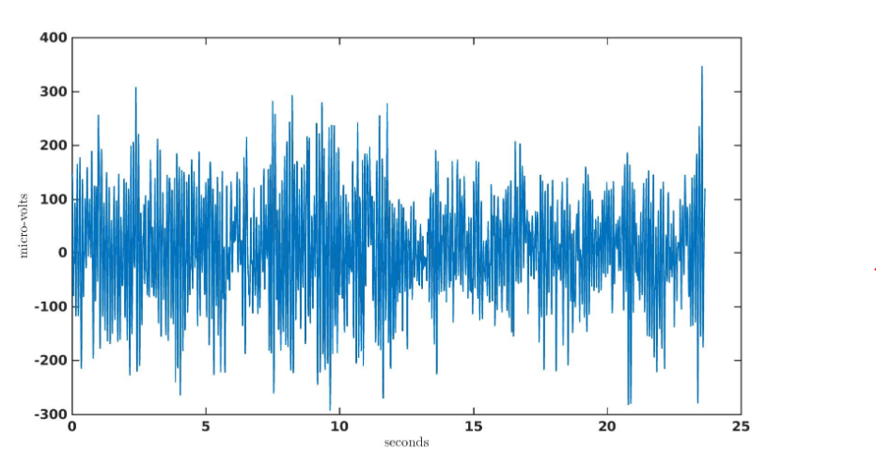
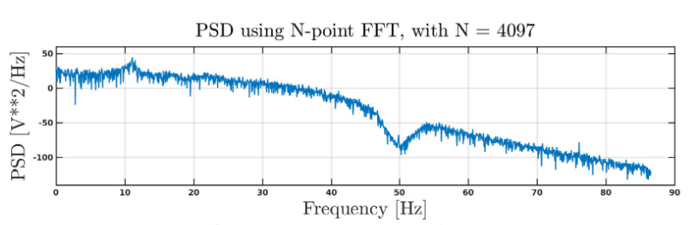
EEG in Frequency domain

Slide 13
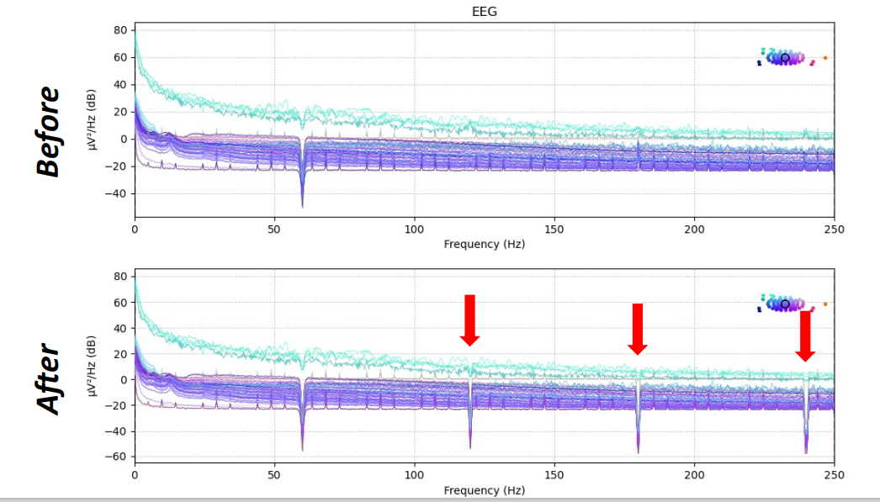
Notch Filtering (Band-Stop)

Slide 14
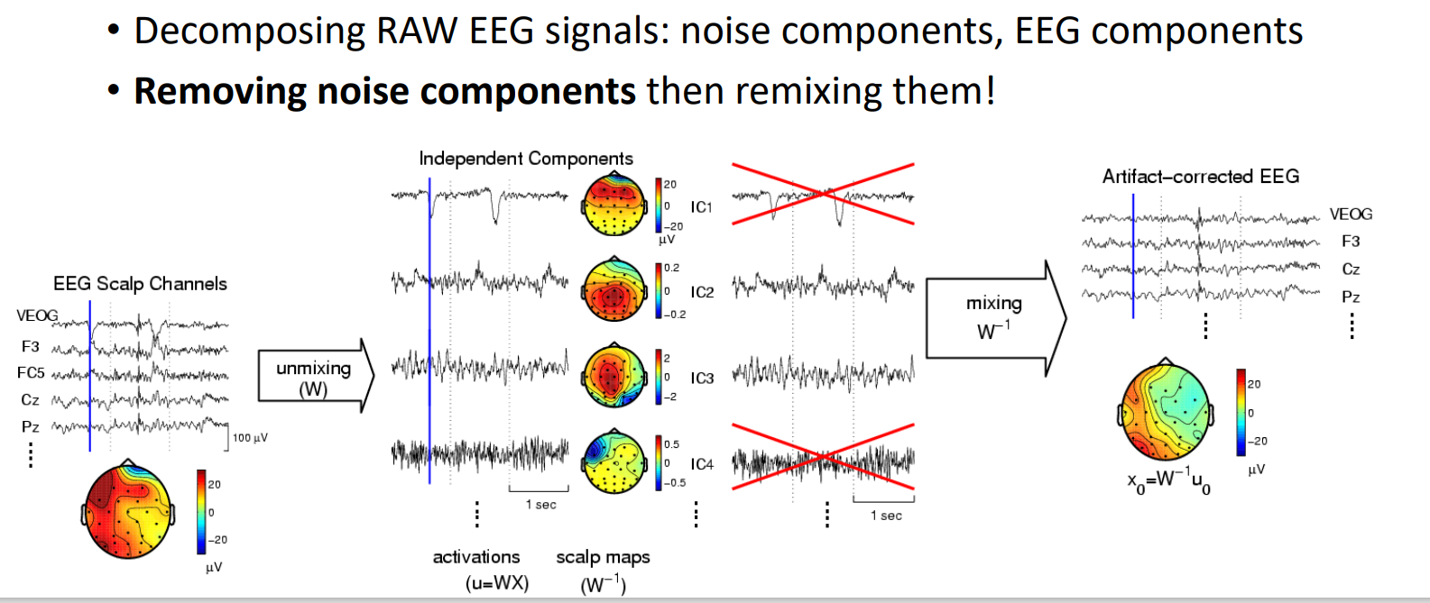
Artifacts Removing
Eye-blink, EOG, EMG (Muscle movement) etc,,,

